Slide 1
PROJECT NAME :- Employee Future Prediction
---Name:-Suvarna Nimonkar
(Batch:-PGA-34)

Slide 2
INTRODUCTION
Build a predictive model that predicts the prospects of future and present employee.
The revenue of this industry was estimated at approximately US$130 billion in 2015–2016 and contributes to 7.7 per cent of the country’s GDP.
The Indian IT/ITeS industry also contributes towards the economic growth of the nation by employing about 10 million people.
According to Mohapatra (2015), the sector is expected to rise at the rate of 12 per cent–14 per cent in 2016–2017 with the expectations of witnessing annual revenues triple times by the year 2025.

Slide 3
Objectives :-
The main objective of this research work is to develop a model that can help to predict whether an employee will leave the company or not.
The essential idea is to measure the effectiveness of employee appraisal and satisfaction rates within the company, which can help to reduce the attrition rate of employees.

Slide 4
Data Description :-
Numeric | Categoryical
YEAR OF JOINING | EDUCATION
PAYMENT TIER | CITY OFFICE
AGE | GENDER
EXPERIENCE IN CURRENT FIELD | EVERBENCHED
LEAVEORNO
Source :- Dataset downloaded from Kaggle.com

Slide 5
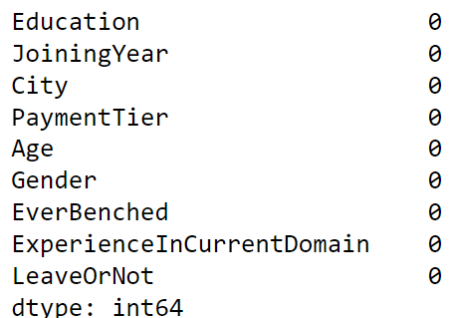
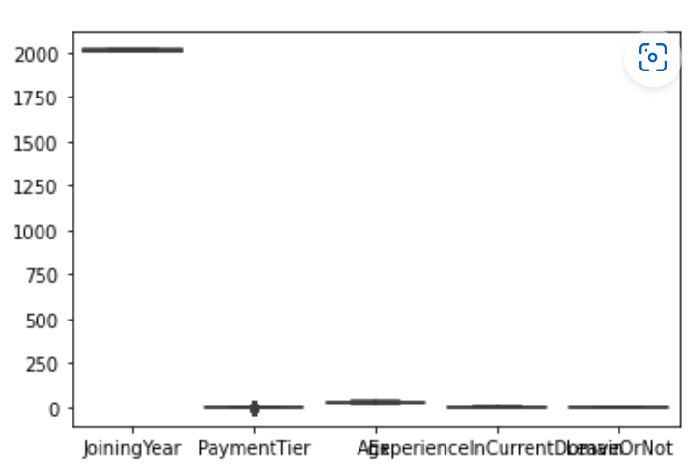
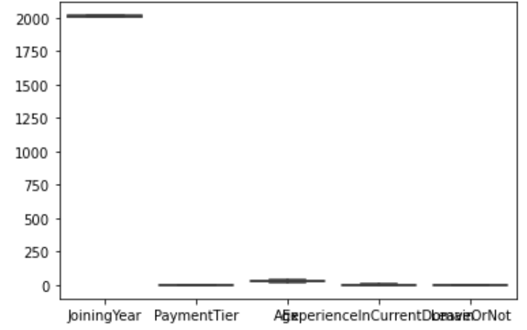
Exploratory Data Analysis
Checking Data Types of Variables.
Checking Missing Values In The Data.
Finding Outliers By Box Whisker Plot.
Remove Outliers By Using Winsorizing
Technique.
With outlier
Remove Outlier
Null Value

Slide 6
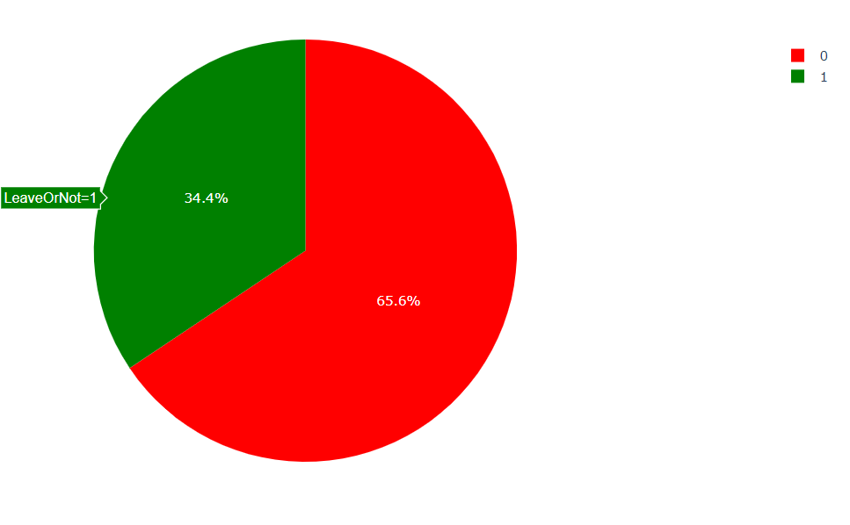
Data Visualisation
Bad Rate
1)Pie Chart
In pie chart 34.4% bad rate.
34.4% Employee leave the Company.
66.6% Employee Can not leave the
Company.

Slide 7
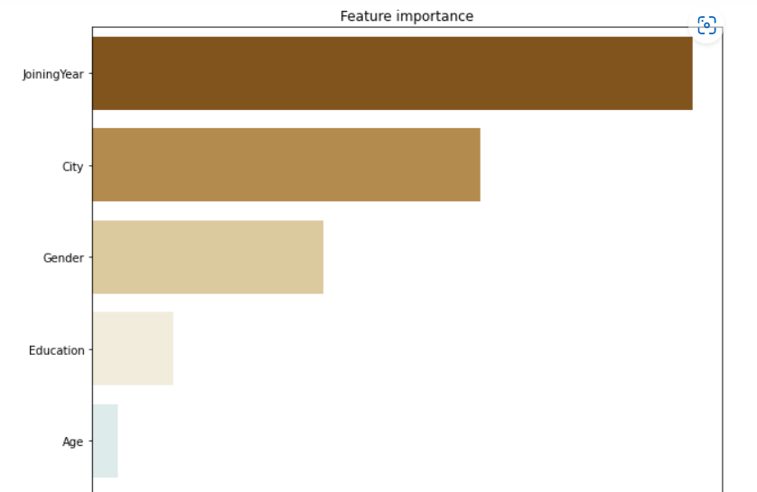
Important Variable And Conclusion -

Slide 8
Data Partition
1)The Dataset is Partitioned to Two Subset 2)Train Dataset : 70% 3)Test Dataset :30% 4)Models use the same partitioned data when applicable
Train = building Model Test = Check Performance of Model

Slide 9
Model Building
Model Type | Accuracy of Model(Train) | Accuracy of Model(Test)
Logistic Regression | 70% | 73%
Decision Tree | 80% | 82%
Random Forest | 80% | 82%
KNN | 82% | 81%

Slide 10
Conclusion :-
EDA
34.4% Employee leave the Company.
Model
We are able to Predict accurate 84% Accuracy
Model is Good fit
High Influence Variable are
Joining Year
Education
Age
city
Gender

Slide 11
Suggestion
Offer benefits and compensation.
Offer flexibility
Salary Prior One day
Increase the Salary of Employee

Slide 12
THANK YOU….!!!

